Slide 1
ABUSE OF POWER
Written by Ardis and Dick Stenbakken
enditnow® EMPHASIS DAY 2022
Prepared by General Conference Women’s Ministries Department
Notes:
POWER OF AUBSE
Written by Ardis and Dick Stenbakken
For enditnow® Emphasis Day 2022
Prepared by General Conference Women’s Ministries
[Note to presenter: We suggest that the presenter to have local or national statistics to share as well as knowledge of local laws, and perhaps current local cases.]
[It is also important to note that neither the sermon nor the seminar cover all that there is to be said on this topic; for instance, very little is said about restoration or punishment—there is just not enough time. It would be well to inquire if your home division has a policy and/or a committee to handle sexual misconduct and abuse in the church or similar resources—you can contact your division Women’s Ministries or Family Ministries for information. A good web site for more information is http://www.thehopeofsurvivors.com/default.asp. It deals primarily with pastoral misconduct, but much of it is applicable to other situations as well. A good book on sexual abuse of power is Sex in the Forbidden Zone by Peter Rutter, Fawcett, 1991.]

Slide 2
ABUSE OF POWER
There is the problem itself,
what the abuse of power means,
how the problem is dealt with so that the problem does not become bigger,
what to do about the problem,
and how to affect restoration.
Both the victim and the abuser need ministry.
Notes:
The subject of abuse of power is a large subject with many ramifications. In the sermon on the abuse of power also prepared for this day we particularly looked at the biblical story of the sin of David and Bathsheba. But there are many other stories and there are many aspects to this problem. There is the problem itself, what the abuse of power means, how the problem is dealt with so that the problem does not become bigger, what to do about the problem, and how to affect restoration. Both the victim and the abuser need ministry. And if the abuse occurs in the church there are often people who do not believe it has happened and take sides, and as a result the church itself suffers.

Slide 3
TYPES OF POWER
POSITIONAL
Pastor
Lawyer
Teacher
Coach
Caregiver
Doctor
Therapist
Church leaders
Youth leaders
Pathfinder leaders
Boss
VIP/political
Husbands/wives
Parents
Notes:
Types of Abuse of Power:
So, what are the elements of power, and who has power? In all cases of abuse of power, abuse takes place when a person takes advantage of a person or group for the benefit of the abuser.
Positional. The use of one’s position, education, status, to command/demand compliance of others without their consent. See Luke 3:14 where John the Baptist tells soldiers to NOT use their position to exploit others.
Some of these positions are:
Pastor
Lawyer
Teacher
Coach
Caregiver
Doctor
Therapist
Church leaders
Youth leaders
Pathfinder leaders
Boss
VIP/political
Husbands/wives
Parents

Slide 4
TYPES OF POWER
ECONOMIC
INFLUENCE
PHYSICAL
INFORMATIONAL
PSYCHOLOGICAL and EMOTIONAL
SPIRITUAL
SEXUAL
Notes:
Economic—the use or misuse of money and trust in managing funds; the person wields power because they have the money—they are looked up to, or they control things or events with their money by either giving or withholding it. Texts: Acts 5:1-12—Ananias and Sapphira; James 5; Deuteronomy 8:18.
Influence—the use of persuasion because they have written a book, are a member of a certain group, have a forceful personality, etc. Think of people in sports, entertainment, music, social media, and other well-known people who influence followers and endorse advertisements. They have the power of persuasion. Wikipedia lists five United States officials who have been impeached for abuse of power. It even lists a case as far back as 215 CE in China. [1]
Physical—usually the use of size and or physical strength to force compliance. This is perhaps obvious—if you are bigger or stronger than I, you have power over me. Texts—Numbers 22:22-27: Balaam beats his donkey. Genesis 37: Joseph’s brothers sell him to slavery. 2 Samuel 13:14: “and since he was stronger than she, he raped her.”
Informational—the use of information that another lacks or needs will often give power to the one who knows. This is particularly true in church leadership and political leadership. If you are on the inside path of information, you can control events and people.
Psychological and Emotional—the use of emotions to dominate, shame, manipulate, or control others. Ephesians 6:4 says, “Do not exasperate your children.” Texts—Genesis 2:1-7: Satan/Eve/Adam intimidating lies = pressure.
Spiritual—the use of spiritual influence or position to command, demand, demean, or force someone into a belief or behavior. Text—John 11:49: Caiaphas, “You know nothing at all!”
Sexual—the exploitation of another for personal sexual gratification. The abuse by these individuals may be in the form of sexual abuse, incest, molestation, or sexual harassment. Note: In many countries there are strong legal guidelines on reporting, and potentially severe legal penalties for this kind of abuse, especially the abuse of minor children. Texts—1 Samuel 2:22-25: Eli’s sons. 2 Samuel 11: David and Bathsheba.
[1] https://en.wikipedia.org/wiki/Abuse_of_power. Accessed 2/16/2022.

Slide 5
THE RESPONSIBILITY OF POWER
The person with the power is also the one who should be held responsible for the situation—not the victim.
Look at the word responsibility—response-ability—the ability to choose your response.
The power differential between the leader and the follower makes the person with the less power vulnerable to exploitation.
—Stephen Covey, The 7 Habits of Highly Effective People
Notes:
In all of these cases, the person with the power is also the one who should be held responsible for the situation—not the victim. Stephen Covey, in his book The 7 Habits of Highly Effective People, has what he calls the proactive model. This means that “as human beings, we are responsible for our own lives. Our behavior is a function of our decisions, not our conditions.” Then he goes on to say, “Look at the word responsibility—‘response-ability’—the ability to choose your response.”[1]
What this clarifies is that the person with the power is the one with the responsibility, and cannot say, “Well, she/he tempted me,” or as in the case of Bathsheba and David, we cannot blame her. David was king and the one responsible. If this were not so, we should have had Psalm 51, a prayer of repentance, from Bathsheba, not David. But he knew he was in the wrong, and so did the prophet Nathan. In fact, 2 Samuel 11:27 says, “But the thing David had done displeased the Lord.”
The pastor, the teacher, the therapist, the Pathfinder leader—whatever person is in charge—is the one responsible and accountable. Larry Spielman, a leader in preventing church professional misconduct says, “The leader’s role produces an implicit trust between the leader and those over whom the leader has power. The leader must not use this sacred trust for personal gratification. The power differential between King and subject, or leader and follower, makes the person with the less power vulnerable to exploitation.”[2]
[1] Page 71.
[2] https://wordandworld.luthersem.edu/content/pdfs/19-3_Politics/19-3_Spielman.pdf Accessed 2/22/2022/

Slide 6
FACTS TO KNOW
Always remember the one in power—power of any type—is the one who is responsible.
We will not be judged by our temptation, but by our response.
Inappropriate sexual contact with a person of the opposite or same sex is sin, even among consenting adults.
If you hear of an abuse case, don’t express disbelief. Abuse happens, even in our church.
Notes:
Some facts we need to know about the abuse of power:
Perhaps the most important fact to always remember is that the one in power—power of any type—is the one who is responsible.
We will not be judged by what temptations people put in front of us, but by our response.
Inappropriate sexual contact with a person of the opposite or same sex is sin, even among consenting adults. This might involve child molestation, adultery, homosexuality, sexual harassment, voyeurism, and other types of inappropriate sexual contact. These sins should not occur among Christians, but they do. When one of the individuals has power (the pastor, church leader, teacher, doctor, etc.) that person always is the responsible one and will need to be held accountable.
If you hear of an abuse case, don’t express disbelief. Unfortunately, things like that do happen, even in our church.

Slide 7
FACTS TO KNOW
When any type of abuse occurs, the objective from that point on is restoration.
Sexual violence includes immediate physical and emotional toll, a wide range of chronic physical and mental health problems, and substantial economic costs (medical care, lost work, criminal justice activities).
Sexual harassment and abuse in schools by coaches and teachers is overshadowed by alleged abuse by priests in the Catholic church but is comparable in magnitude.
Notes:
Some facts we need to know about the abuse of power (cont):
When any type of abuse occurs, the objective from that point on is restoration. This involves such components as confrontation, confession, repentance, personal counseling, marriage or family counseling, and accountability groups. The restoration process is not easy and it takes time. In not all cases is restoration possible or appropriate. Above all, do not just pretend it never happened and move the perpetrator somewhere else.
Findings from CDC’s National Intimate Partner and Sexual Violence Survey (NISVS) indicate that millions of Americans are affected by sexual violence (SV), stalking, and intimate partner violence (IPV) every year. In addition to the immediate physical and emotional toll, a wide range of chronic physical and mental health problems are associated with these forms of violence. Impact is felt well beyond an individual victim, with substantial economic costs across victims' lifetimes due to medical care, lost work, and criminal justice activities.[1] We need to recognize that these acts of abuse could not, would not happen if there was not power on the part of the abuser.
“According to Robert Shoop, a Kansas State University expert who has studied sexual harassment and abuse in schools, this abuse isn’t just limited to coaches. Band directors, music teachers or anybody who has access to your child in a private environment outside of the school setting could also be a predator as well…. But that’s not to say your kids are any safer in school classrooms. Reported incidents of teacher-student sex cases are becoming more and more common. Shoop said that these cases are probably the tip of the iceberg in regards to the number of cases; however, no national [USA] studies exist to discuss how prevalent a problem it truly is. Yet, he said the scandal is comparable in magnitude to (but has been overshadowed by) the incidents of alleged abuse by priests in the Catholic Church.”[2]
[1] https://www.cdc.gov/violenceprevention/pdf/nisvs/NISVS-overview.pdf. Accessed 2/24/2022.
[2] http://www.mediarelations.k-state.edu/WEB/News/Webzine/0202/sexualabuse.html. Accessed 2/24/2008.

Slide 8
FACTS TO KNOW
No church is immune.
When sexual misconduct occurs, the church needs to adopt specific procedures.
Every individual involved with children should complete a volunteer application form and undergo appropriate background checks.
If you become aware of abuse by any church leader, a quick response is vital.
Notes:
Some facts we need to know about the abuse of power (cont):
No church is immune. “America’s largest Protestant denomination, the Southern Baptist Convention, was recently rocked by reports of over 700 cases of sexual abuse by nearly 400 church leaders spanning 20 years. Worse, some denominational leaders knew of the problems but didn’t stop the perpetrators. Indeed, many were repeat offenders who would leave one congregation only to prey on another. This is a horrific, sinful, and gross betrayal of God and God’s people.” [1] We have heard many reports about abuse in the Catholic Church, but it is not alone in this.
When sexual misconduct occurs, the church needs to adopt specific procedures. On one hand, stating specific actions can be helpful. But on the other hand, being too specific can make it impossible to follow the adopted procedure in every case. Failure to follow adopted procedures can result in litigation.
Every individual involved with children should complete a volunteer application form and undergo appropriate background checks. [2] ARM (Adventist Risk Management) has guidelines to help pastors on how to deal with staff and volunteers.[3] (For more information from ARM go to: https://women.Adventist.org/protecting-our-children)
If you become aware of abuse by any church leader, a quick response is vital. Contact the Conference, Adventist Risk Management, and your attorney.
[1] https://www.thebanner.org/columns/2019/04/abuse-of-power. Accessed 2/24/2022.
[2] https://adventistrisk.org/en-us/safety-resources/solutions-newsletter/2022/january/nadeng-before-they-volunteer. Accessed 3/30/2022
[3] https://adventistrisk.org/en-us/safety-resources/topics/child-protection. Accessed 3/30/2022

Slide 9
FACTS TO KNOW
Regardless of the accusation, the mission of the church must be to protect the abused, to listen to the victim, and to cooperate with the authorities.
If you are a church leader and someone comes to you for counseling, unless what they tell you is illegal, you must keep the confidence. To share what you hear with anyone else in the church can ruin your ministry and their spiritual walk.
Notes:
Some facts we need to know about the abuse of power (cont):
Remember that regardless of the accusation, the mission of the church must be to protect the abused, to listen to the victim, and to cooperate with the authorities.
If you are a church leader and someone comes to you for counseling, unless what they tell you is illegal, you must keep the confidence. To share what you hear with anyone else in the church can ruin your ministry and their spiritual walk.

Slide 10
FACTS TO KNOW
“Another factor misinterprets gospel mandate to forgive sinners. Thus, pastor sexual misconduct is viewed more as a moral lapse than as a betrayal of professional trust.” — James A. Cress
Responding in the wrong ways makes church leader misconduct in the congregation worse. Know the guidelines.
The mission of the church or institution is damaged by abuse of power. Understanding the negative consequences can motivate the institution to act against leaders abusing power.
Notes:
Some facts we need to know about the abuse of power (cont):
“Another factor misinterprets the gospel mandate to forgive sinners. Thus, pastoral sexual misconduct is viewed more as a moral lapse than as a betrayal of professional trust. Of course, this ignores the Savior’s directive that those who harm little ones should be severely, even irretrievably, punished. Remember, sexual misconduct is seldom a need for a sexual relationship as much as it is an abuse of power and position.” —“Organizational Misconduct,” James A. Cress, September 2002, Ministry® International Magazine for Pastors.[1]
How do you make church leader misconduct in the congregation worse? By responding in the wrong ways. The problem of pastoral misconduct affects all denominations. The Adventist Church Risk Management has guidelines that should be accessed as well as finding what the guidelines for where you are located.
Author Naomi Wolf was sexually harassed as an undergraduate at Yale University in the 1980’s. She has written about her years of struggle to determine what Yale has done to hold its faculty accountable. She concludes that abuse of power damage an institution or a church’s larger mission. She says, “The Catholic Church is a good example: The public understood that church leaders’ maintaining silence about systemic sexual transgressions corrupted the mission of an organization that had a great responsibility to society as a whole.” She says that “even the military is starting to understand that this type of sexual harassment of cadets corrupts its social mission.” So if the institution looks at how its mission is damaged when one of its leaders/employees/representative engages in abuse of power, it might be motivated to act when it recognized its self-interest and potential negative consequences it may face (legal, financial, public image, etc.) which can undercut its mission and indeed, its survival. [2]
[1] Published monthly since 1928 by the Seventh-day Adventist Church and read by clergy of all faiths.
[2] Information from Dr. Marie M. Fortune, Founder and Senior Analyst, FaithTrust Institute, in a promotional e-mail.

Slide 11
STEPS TO AVOID FALLING INTO SIN
IF YOU ARE THE PERSON IN POWER:
Have an accountability partner.
Leave the office door open and the window uncovered.
Keep your desk between you and your counselee at all times as a physical barrier.
Avoid even casual physical contacts.
Counsel only with couples or with members of the same sex.
Never assume that you are invincible.
Notes:
Steps for the one in power to use to Avoid falling Into sin:
If you are one of the persons with power, particularly one of those in a power position, you need to take steps to make sure you do not fall into causing abuse. Unfortunately, many who have caused abuse felt that they were not vulnerable—they didn’t even need to take precautions. But anyone can fall into trouble if safety measures are not taken. To help protect yourself, here are steps you should take.
Have an accountability partner or group and meet with them regularly and honestly.
Leave the office door open and the window in it uncovered.
Keep your desk between you and your counselee at all times as a physical barrier.
Avoid even casual physical contacts.
Counsel only with couples or with members of the same sex (men counsel with men, women counsel with women).
Never assume that you are invincible. Given the wrong circumstances, every pastor [or other person in power] is vulnerable to temptation, sin and the abuse of power.[1]
And if you are dealing with one of these persons in power, you should check to see that they are taking steps to protect you.
[1] http://www.thehopeofsurvivors.org/take-precautions/. Accessed 2/24/2022.

Slide 12
THE IMPORTANCE OF CHURCH DISCIPLINE
Most churches assume that they will never have a case of abuse.
And, therefore have no plans how to take care of the problem.
One of the most common ways of dealing with a problem of abuse of power has been to sweep it under the rug.
But dealing with the abuser is vitally important.
Notes:
The Importance of Church Discipline
Most churches assume that they will never have a case of abuse and therefore have no plans as to how to take care of the problem. One of the most common ways of dealing with a problem of abuse of power has been to sweep it under the rug.
But dealing with the abuser is vitally important. Jay A. Quine, a pastor, a judge, and a former deputy prosecutor is quoted as saying, “Discipline is not optional. It is mandatory in Scripture.”

Slide 13
SCRIPTURE CALLS
for discipline of erring
CHURCH MEMBERS
Notes:
He points out, “Many passages in Scripture call for discipline of erring church members. These passages lead to the in-evitable conclusion that church discipline is as much the function of a local church as the preaching of the ‘pure doctrine of the gospel….’”[1]
Matthew 18:15-20 teaches that a sinner is to be confronted, reproved and, if they refuse to repent, excluded from the church.
Acts 5:1-11 illustrates the seriousness of sin within the church, the sensitivity of the Holy Spirit to sin, and the quick judgment of God upon sin.
1 Corinthians 5:1-5 teaches that the church's response to persistent, unrepentant sin is to grieve, deliberate, judge the sin, and exclude the unrepentant member.
1 Thessalonians 5:14 commands us to warn the disobedient and the disorderly.
2 Thessalonians 3:6-15 teaches us to warn the undisciplined brother and withdraw from him.
1 Timothy 5:20 tells us to rebuke persistent sin publicly.
Titus 1:13 says to severely reprove those who teach untruth.
Titus 3:10 commands us to withdraw from a person who causes divisions, but only after adequate warning.
Revelation 2-3 calls churches to repentance and warns of impending discipline if they refuse.
It is clear that God intends the church to take this seriously and to take corrective measures when members persist in sinning.
[1] http://d3pi8hptl0qhh4.cloudfront.net/documents/sbjt/sbjt_2000winter6.pdf. Accessed 2/25/2022.

Slide 14
Matthew 18:15-20 teaches that a sinner is to be confronted, reproved and, if they refuse to repent, excluded from the church.
Acts 5:1-11 illustrates the seriousness of sin within the church, the sensitivity of the Holy Spirit to sin, and the quick judgment of God upon sin.

Slide 15
1 Corinthians 5:1-5 teaches that the church's response to persistent, unrepentant sin is to grieve, deliberate, judge the sin, and exclude the unrepentant member.

Slide 16
1 Thessalonians 5:14 commands us to warn the disobedient and the disorderly.
2 Thessalonians 3:6-15 teaches us to warn the undisciplined brother and withdraw from him.
1 Timothy 5:20 tells us to rebuke persistent sin publicly.

Slide 17
Titus 1:13 says to severely reprove those who teach untruth.
Titus 3:10 commands us to withdraw from a person who causes divisions, but only after adequate warning.
Revelation 2-3 calls churches to repentance and warns of impending discipline if they refuse.

Slide 18
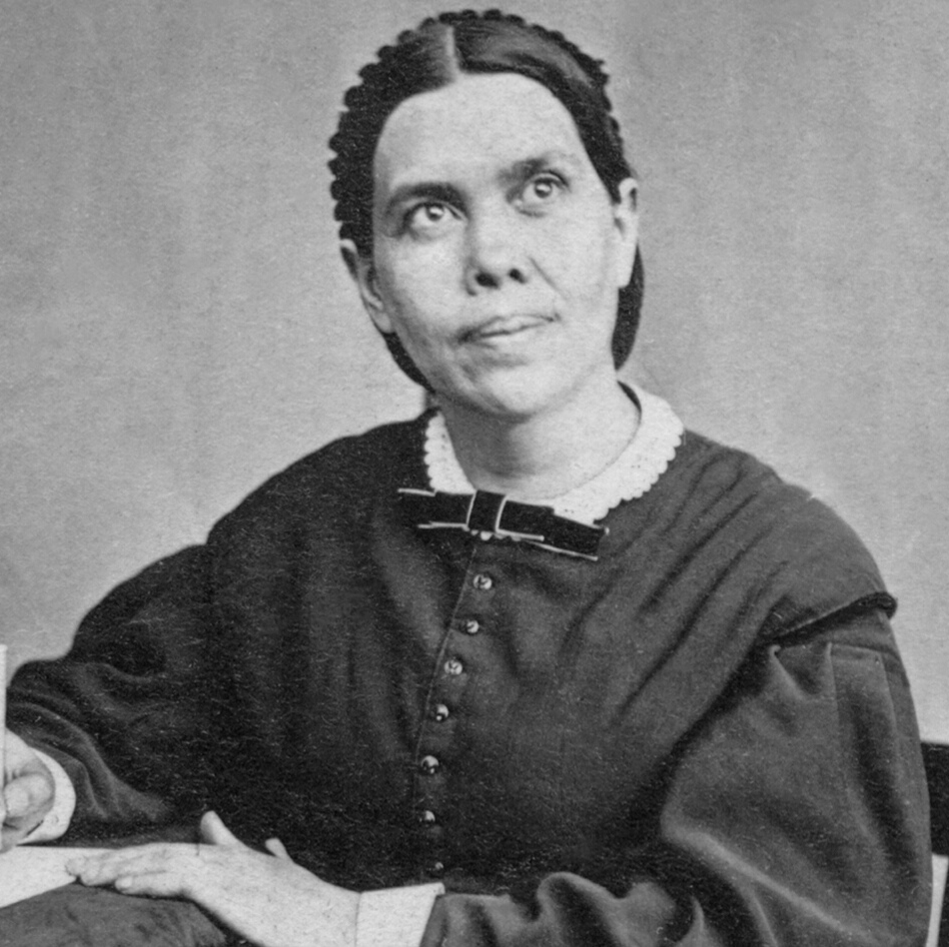
ELLEN G. WHITE ON THE ABUSE OF POWER
Notes:
Ellen G. White statements on the abuse of power
“Many who profess to be the ministers of Christ are like the sons of Eli who ministered in the sacred office and took advantage of their office to engage in crime and commit adultery, causing the people to transgress the law of God. A fearful account will such have to render when the cases of all shall pass in review before God, and they be judged according to the deeds done in the body…. Adultery is one of the terrible sins of this age. This sin exists among professed Christians of every class….” —The Sin of Licentiousness, Testimonies on Sexual Behaviour, Adultery, and Divorce (1989), 99.2.

Slide 19
“Many who profess to be the ministers of Christ are like the sons of Eli who ministered in the sacred office and took advantage of their office to engage in crime and commit adultery, causing the people to transgress the law of God. A fearful account will such have to render when the cases of all shall pass in review before God, and they be judged according to the deeds done in the body…. Adultery is one of the terrible sins of this age. This sin exists among professed Christians of every class….”
—The Sin of Licentiousness, Testimonies on Sexual Behaviour, Adultery, and Divorce (1989), 99.2.

Slide 20
“If a minister of the gospel does not control his baser passions, if he fails to follow the example of the apostle and so dishonors his profession and faith as to even name the indulgence of sin, our sisters who profess godliness should not for an instant flatter themselves that sin or crime loses its sinfulness in the least because their minister dares to engage in it.
(continued)
Notes:
Ellen G. White Statement Regarding the Abuse of Power
“If a minister of the gospel does not control his baser passions, if he fails to follow the example of the apostle and so dishonors his profession and faith as to even name the indulgence of sin, our sisters who profess godliness should not for an instant flatter themselves that sin or crime loses its sinfulness in the least because their minister dares to engage in it.” —Testimonies for the Church, vol. 2, 457.1

Slide 21
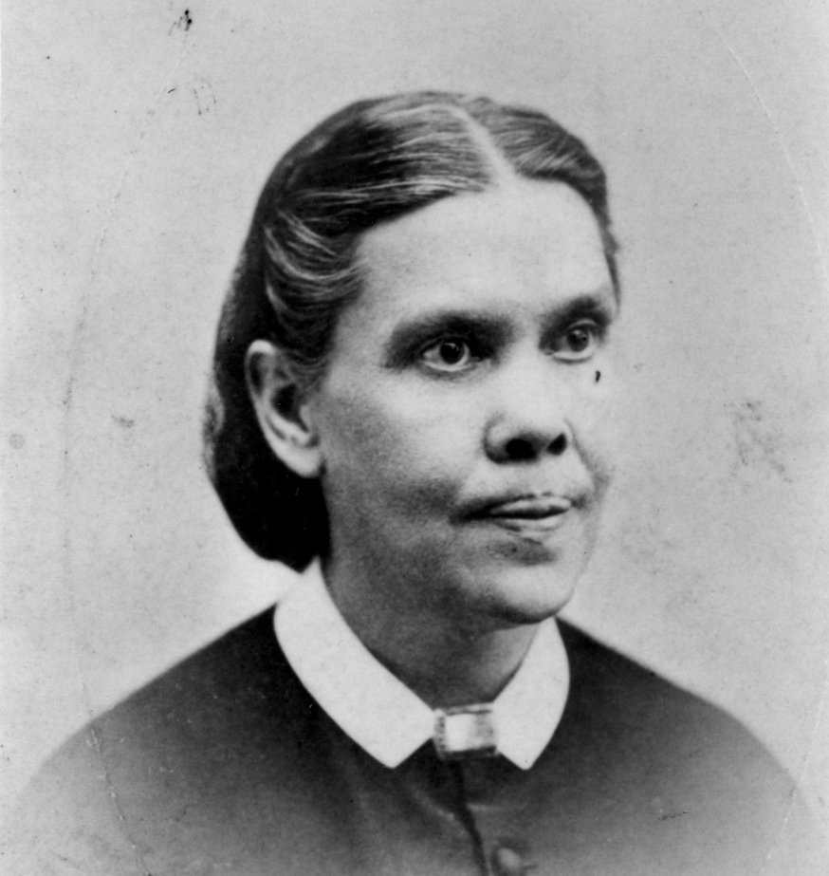
The fact that men who are in responsible places show themselves to be familiar with sin should not lessen the guilt and enormity of the sin in the minds of any. Sin should appear just as sinful, just as abhorrent, as it had been heretofore regarded; and the minds of the pure and elevated should abhor and shun the one who indulges in sin, as they would flee from a serpent whose sting was deadly.”
—Testimonies for the Church, vol. 2, 457.1
Notes:
Ellen G. White Statement Regarding the Abuse of Power
“The fact that men who are in responsible places show themselves to be familiar with sin should not lessen the guilt and enormity of the sin in the minds of any. Sin should appear just as sinful, just as abhorrent, as it had been heretofore regarded; and the minds of the pure and elevated should abhor and shun the one who indulges in sin, as they would flee from a serpent whose sting was deadly.” —Testimonies for the Church, vol. 2, 457.1

Slide 22
“When a man professing to keep God's holy law, and ministering in sacred things, takes advantage of the confidence his position gives him and seeks to indulge his base passions, this fact should of itself be sufficient to enable a woman professing godliness to see that, although his profession is as exalted as the heavens, an impure proposal coming from him is from Satan disguised as an angel of light. I cannot believe that the word of God is abiding in the hearts of those who so readily yield up their innocency and virtue upon the altar of lustful passions.”
—Testimonies for the Church, vol. 2, 457.2
Notes:
Ellen G. White Statement Regarding the Abuse of Power
“When a man professing to keep God's holy law, and ministering in sacred things, takes advantage of the confidence his position gives him and seeks to indulge his base passions, this fact should of itself be sufficient to enable a woman professing godliness to see that, although his profession is as exalted as the heavens, an impure proposal coming from him is from Satan disguised as an angel of light. I cannot believe that the word of God is abiding in the hearts of those who so readily yield up their innocency and virtue upon the altar of lustful passions.” —Testimonies for the Church, vol. 2, 457.2.

Slide 23
MISUSE AND ABUSE OF POWER Chapters 2 through 4 of 1 Samuel
Notes:
Misuse and Abuse of Power
Chapters 2 through 4 of 1 Samuel
There are many stories of the misuse and abuse of power which are recorded for our warning and learning in the Bible. One of the saddest and most complete illustrations of multiple types of the abuse of power at several levels can be found in 1 Samuel chapters 2 through 4.
[As a workshop leader, read these chapters in advance, and mark some of the texts which illustrate the multiple abuses catalogued in the chapters.]
[Below you will find a list of specific texts, and the issues of abuse they illustrate. You may wish to challenge the group to look for, find, and list the various kinds of abuse they can find. If you do it that way, it would be helpful to list the text and the abuse issue on a board, overhead, or some other way so that all can see the textual reference and the abuse as they are uncovered. This will help fix the story and warnings in the minds of participants.]

Slide 24
I Samuel 2
2:3: “The Lord is a God who knows and by him deeds are weighed.” (This sets the stage for the warnings to be gained from what follows)
2:9, 10: “It is not by strength that one prevails. Those who oppose the Lord will be shattered. (Again, this is a warning and an introduction to what will be shared)
2:12: “Eli’s sons had no regard for (did not know) the Lord.” (In other words, they were not real. They were fakes pretending to be religious leaders; religious abuse)
Notes:
Misuse and Abuse of Power
Chapters 2 through 4 of 1 Samuel
I Samuel 2
2:3: “The Lord is a God who knows and by him deeds are weighed.” (This sets the stage for the warnings to be gained from what follows)
2:9, 10: “It is not by strength that one prevails. Those who oppose the Lord will be shattered. (Again, this is a warning and an introduction to what will be shared)
2:12: “Eli’s sons had no regard for (did not know) the Lord.” (In other words, they were not real. They were fakes pretending to be religious leaders; religious abuse)

Slide 25
I Samuel 2
2:12-16: They intimidated the people and essentially robbed them. They had no regard for the people. (positional and religious abuse)
2:17: The abusive behavior is labeled as sin.
2:22-25: They had no regard for the women who served at the temple. They used their position to be sexually and religiously abusive. (positional, sexual, and religious abuse)
Notes:
Misuse and Abuse of Power
Chapters 2 through 4 of 1 Samuel
2 Samuel 2
2:12-16: They intimidated the people and essentially robbed them. They had no regard for the people. (positional and religious abuse)
2:17: The abusive behavior is labeled as sin.
2:22-25: They had no regard for the women who served at the temple. They used their position to be sexually and religiously abusive. (positional, sexual, and religious abuse)

Slide 26
I Samuel 3
3:1: The abusive atmosphere and activity was directly related to a spiritual decline and lack of connection with God. “In those days the word of the Lord was rare; there were not many visions.” (Such is the result of abuse on the entire community, not just on those directly involved)
Notes:
Misuse and Abuse of Power
Chapters 2 through 4 of 1 Samuel
1 Samuel 3
3:1: The abusive atmosphere and activity was directly related to a spiritual decline and lack of connection with God. “In those days the word of the Lord was rare; there were not many visions.” (Such is the result of abuse on the entire community, not just on those directly involved)

Slide 27
I Samuel 4
4:10: The losses sustained by the community were great:
30,000 fell in battle.
The Ark of God was captured.
Eli’s two sons and leaders died.
4:18: Eli dies when he hears the negative news.
4:21, 22: The glory departed from the people and nation, because of the multiple abuses of power chronicled in these chapters.
Notes:
Misuse and Abuse of Power
Chapters 2 through 4 of 1 Samuel
1 Samuel 4
4:10: The losses sustained by the community were great:
30,000 fell in battle.
The Ark of God was captured.
Eli’s two sons and leaders died.
4:18: Eli dies when he hears the negative news.
4:21, 22: The glory departed from the people and nation, because of the multiple abuses of power chronicled in these chapters.
Such are the negative results of abusing power. The same is true today as it was in the days of Eli, his sons, and Samuel. God has not changed. His expectations are the same.

Slide 28
JEREMIAH 7:1-7 REMINDS US . . .
Notes:
Jeremiah 7:1-7 reminds us. . .

Slide 29
We are to reform/change our ways:
Change our actions
Deal justly
Not oppress the powerless
Not shed innocent blood (the ultimate abuse)
Not to follow other gods (including the drunken god of power and abuse)
THEN, wonderful things happen for the people of God.
Notes:
We are to reform/change our ways:
Change our actions.
Deal justly.
Not oppress the powerless.
Not shed innocent blood (the ultimate abuse).
Not follow other gods (including the drunken god of power and abuse).
THEN, wonderful things will happen for the people of God.

Slide 30
WHEN POWER IS ABUSED . . .
Notes:
When power is abused . . .

Slide 31
God is dishonored, sin is rampant, and the results can be devastating for the entire community, not just on the abused and the abuser.
“The Lord is a God who knows and by him deeds are weighed” (1 Samuel 2:3).
When we violate the boundaries of others, we violate them as well as their boundaries.
Notes:
God is dishonored, sin is rampant, and the results can be devastating for the entire community, not just on the abused and the abuser.
Thus, we must all be aware of, withdraw from, and live above the abusive use of power. We must individually and corporately hold those who are in power absolutely accountable so power may be used to the glory of God and for the betterment of all.
Remember, “The Lord is a God who knows and by him deeds are weighed” (1 Samuel 2:3).
Violation of boundaries is one of the marks of abuse. We all need and have many boundaries. When those boundaries are violated, we are violated. When we violate the boundaries of others, we violate them as well as their boundaries.

Slide 32
“A new commandment I give to you, that you love one another; as I have loved you, that you also love one another. By this all will know that you are My disciples, if you have love for one another." —John 13:34, 35, NKJV
Notes:
“A new commandment I give to you, that you love one another; as I have loved you, that you also love one another. By this all will know that you are My disciples, if you have love for one another” (John 13:34, 35, NKJV).

